Slide 1
3D PRINTING
Vocabulary

Slide 2
KEY TERMS
Materials
  Filament
  ABS
  PLA
Parts of a Printer
  Build Plate
  Extruder
Settings
  Raft
  Resolution
  Supports
  Shells
  Infill
  Layers
Design Tools
  Hole Tool
  Work Plane
  Snap Grid
  Group
  Ungroup

Slide 3
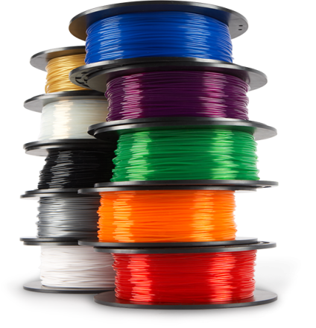
MATERIALS
Filament
ABS
PLA

Slide 4
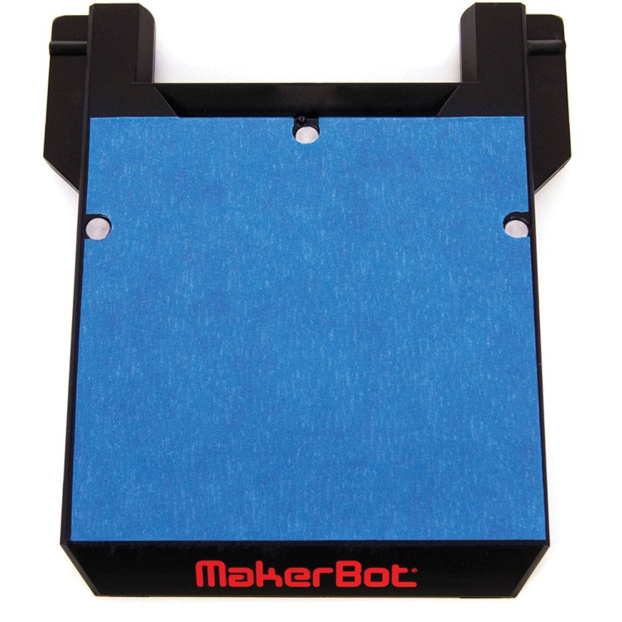
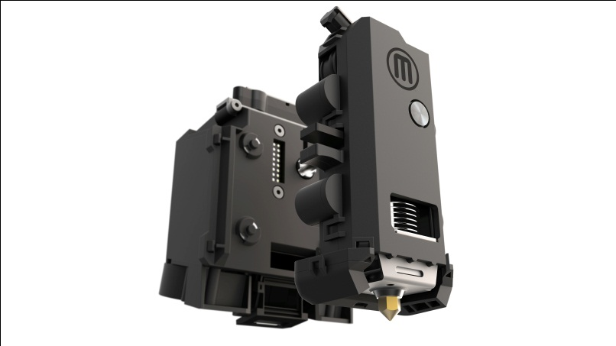
PARTS OF THE PRINTER
Build Plate
Extruder

Slide 5
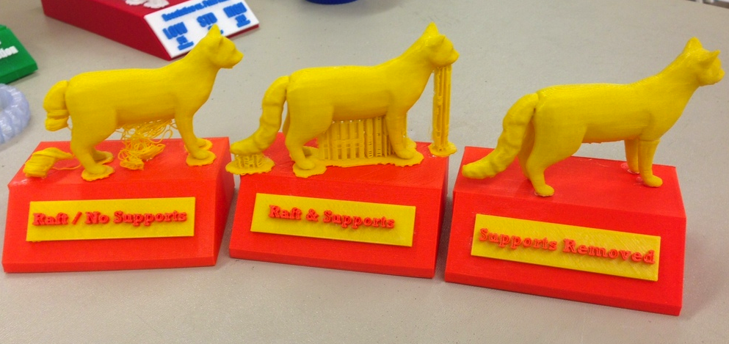
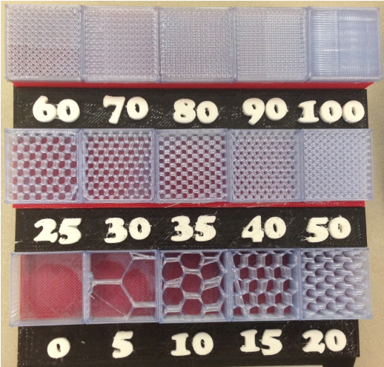
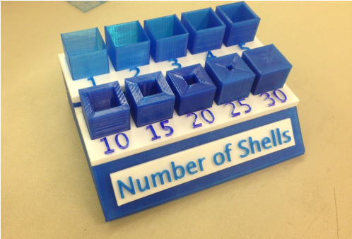
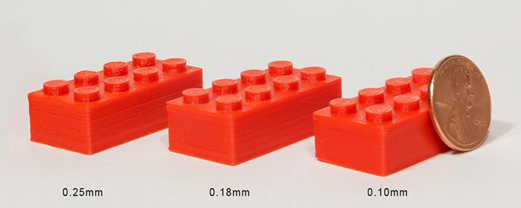
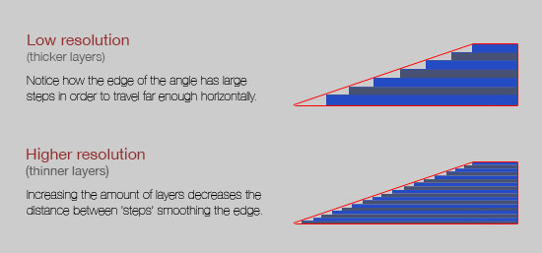
SETTINGS
Raft
Resolution
Supports
Shells
Infill
Layers

Slide 6
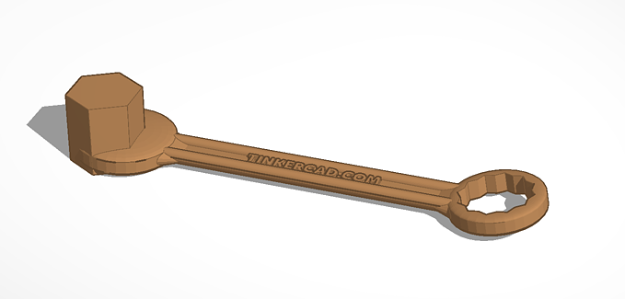
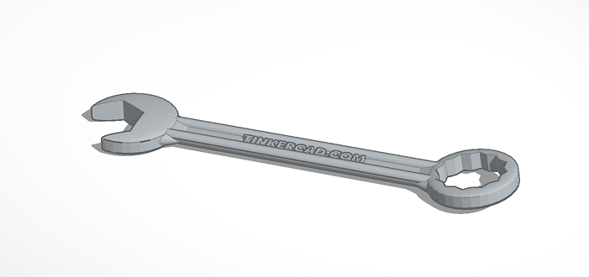
DESIGN TOOLS: HOLE TOOL

Slide 7
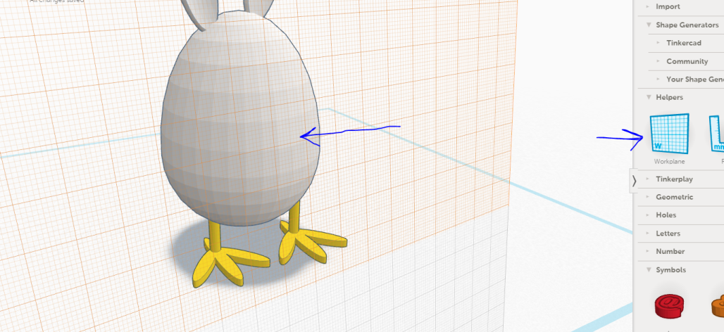
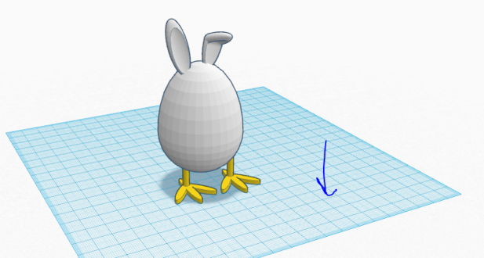
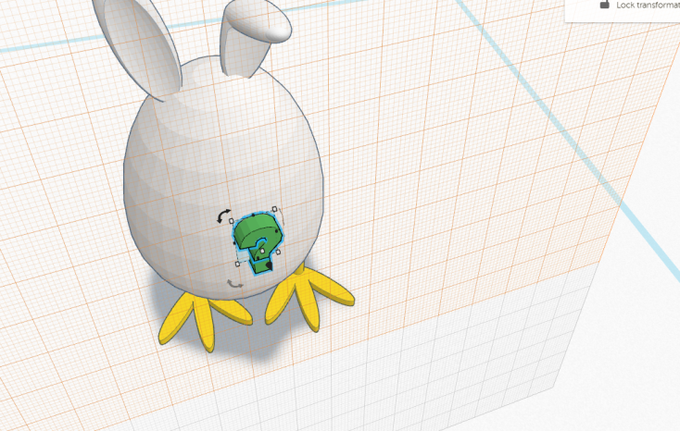
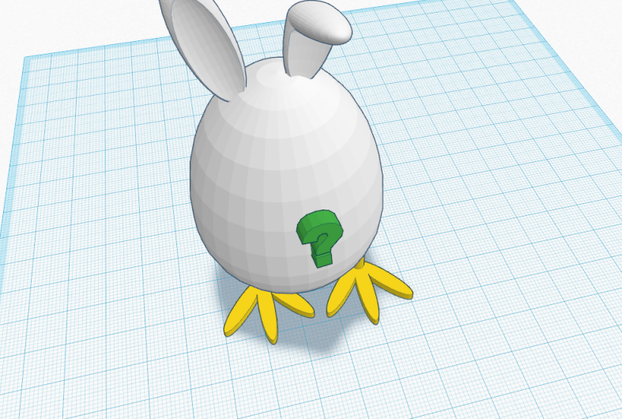
DESIGN TOOLS: WORK PLANE

Slide 8
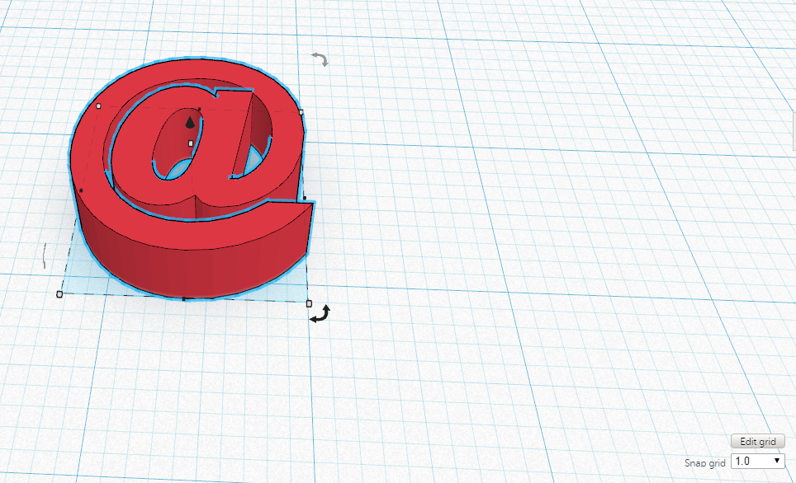
DESIGN TOOLS: SNAP GRID

Slide 9
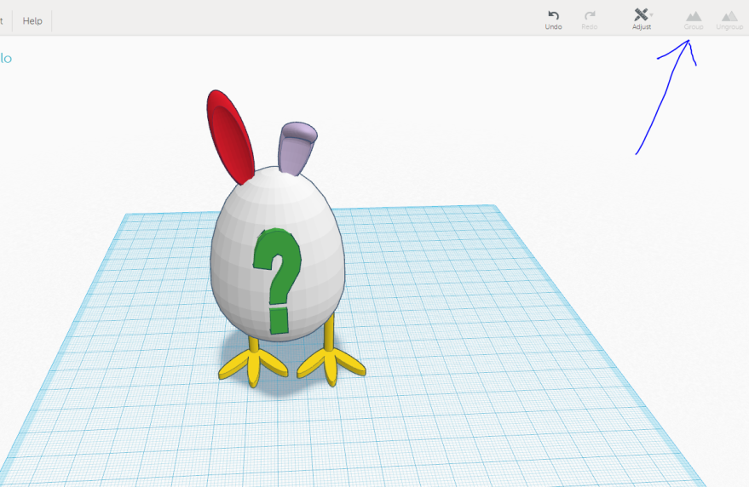
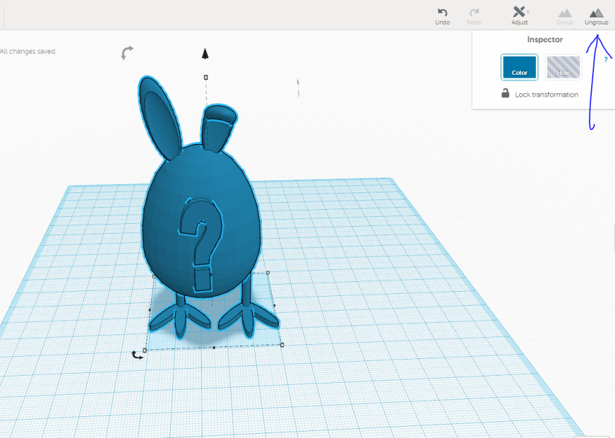
DESIGN TOOL: GROUP /UNGROUP

